Slide 1



Lava Flow Simulation

Slide 2
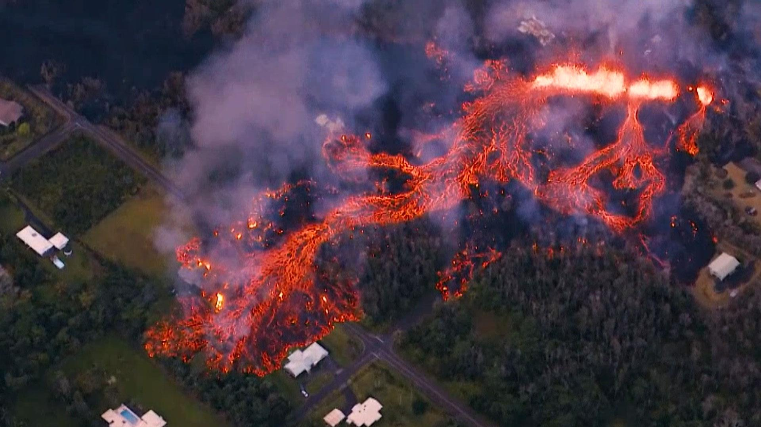
Why lava flows ?
- Prevention

Slide 3
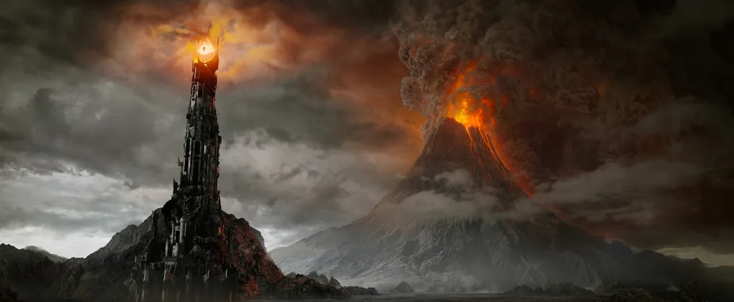
Why lava flows ?
- Prevention
- Entertainment

Slide 4
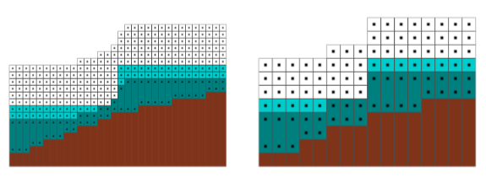
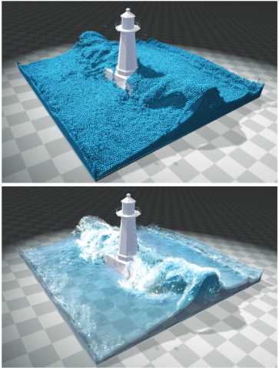
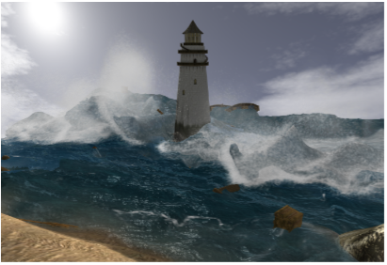
Existing methods: Fluid simulation
Eulerian models
Lagrangian models
from Real-Time Eulerian Water Simulation Using a Restricted Tall Cell Grid, Müller et al.
from SPH Fluids in Computer Graphics, Ihmsen et al.

Slide 5
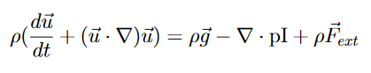
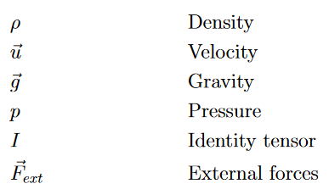
Existing methods: From 3D to 2D
3D Navier-Stokes Equation
2D Shallow Water Equations

Slide 6
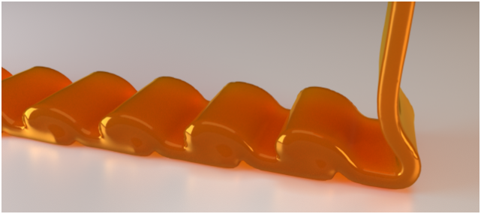
Existing methods: Viscosity
Explicit schemes
Implicit schemes
X(t+dt) = f(x(t))
+ Fast per time step
Needs small steps to be stable
(CFL dependant of viscosity so not used)
X(t+dt) = f(x(t+dt), x(t))
+ Time step size independent
- Linear system to solve
from A Physically Consistent Implicit Viscosity Solver for SPH Fluids, Weiler et al.

Slide 7
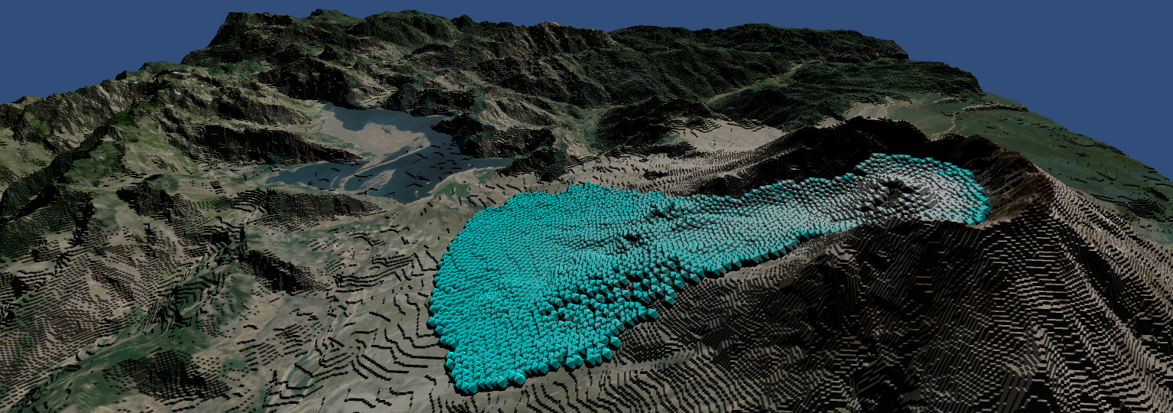
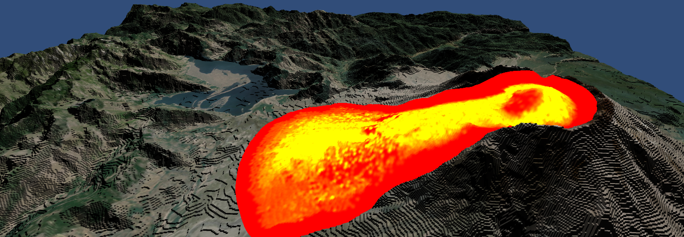
Our method

Slide 8
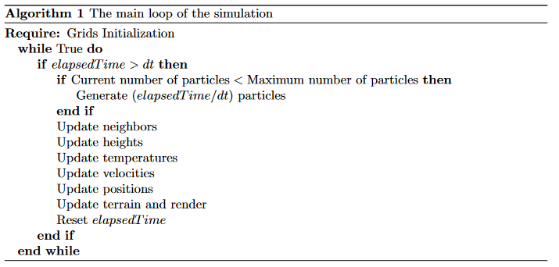
The algorithm

Slide 9
The algorithm

Slide 10

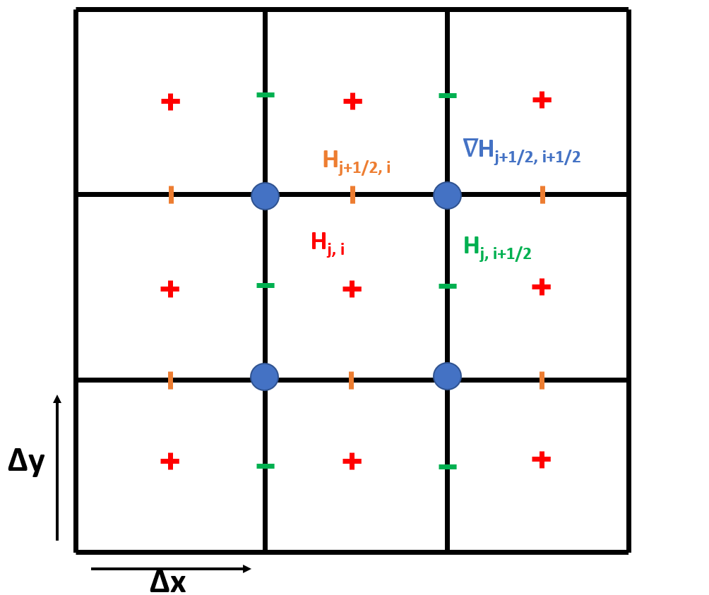
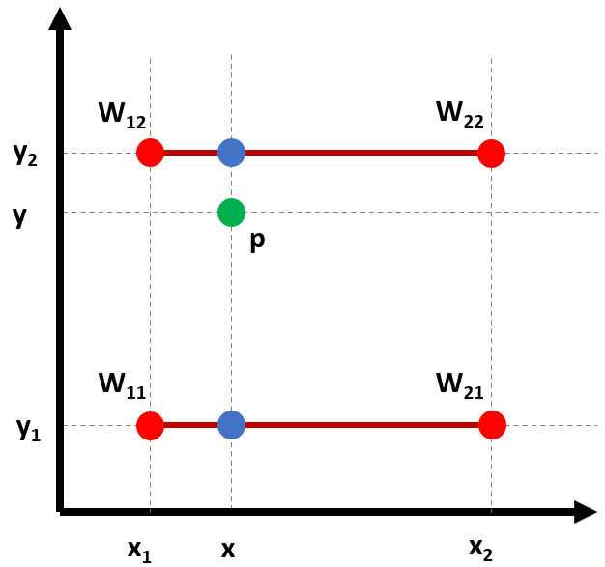
The Staggered grid
Heightmap
Staggered grid
Interpolation

Slide 11
The algorithm

Slide 12
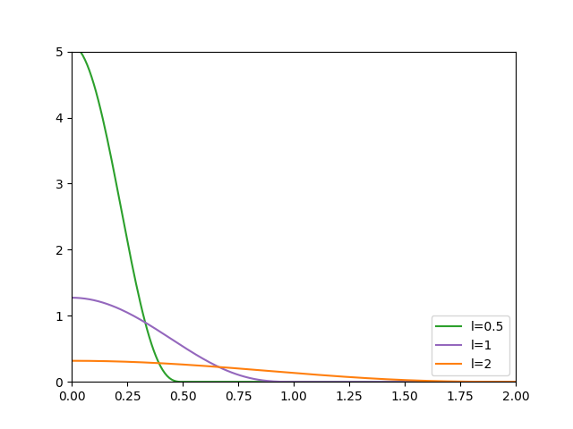
Smoothed Particles Hydrodynamics
3D Sph formulas
i
Usual Smoothing kernel : Wpoly6

Slide 13
Smoothed Particles Hydrodynamics
2D Sph formulas
i
Usual Smoothing kernel : Wpoly6

Slide 14
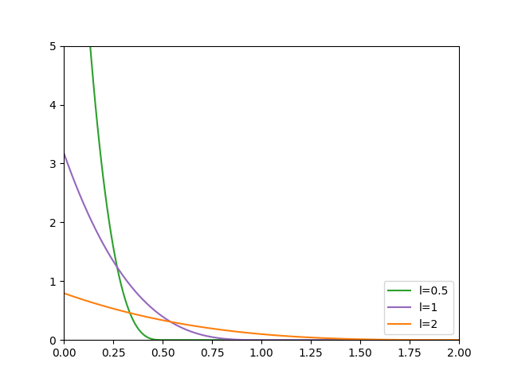
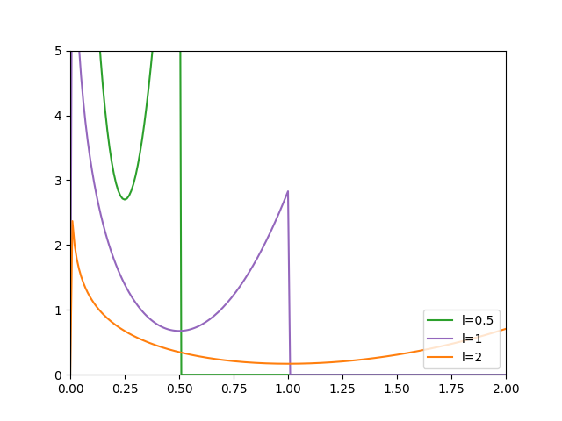
Smoothed Particles Hydrodynamics
Wpoly6
Wspiky
Wvisc

Slide 15
The algorithm

Slide 16
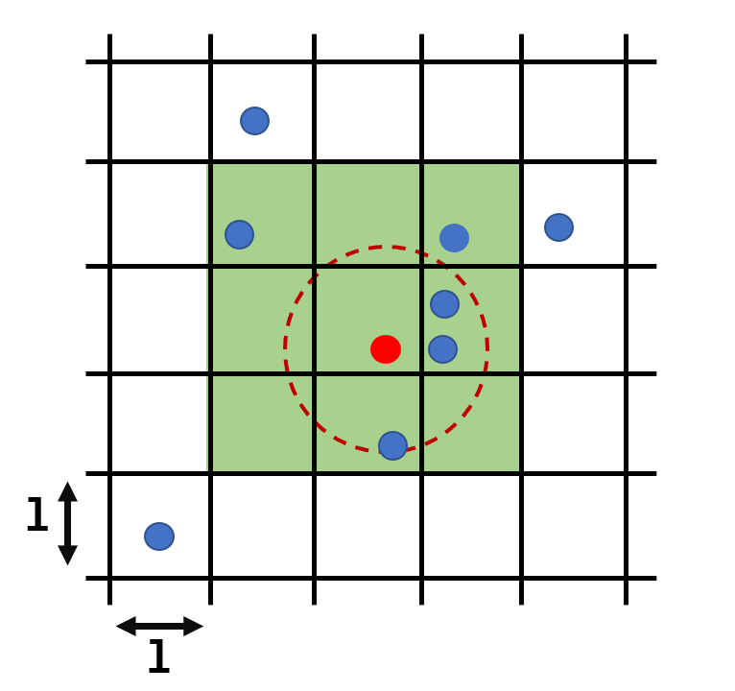
The neighbors grid
Few particles

Slide 17
The algorithm

Slide 18
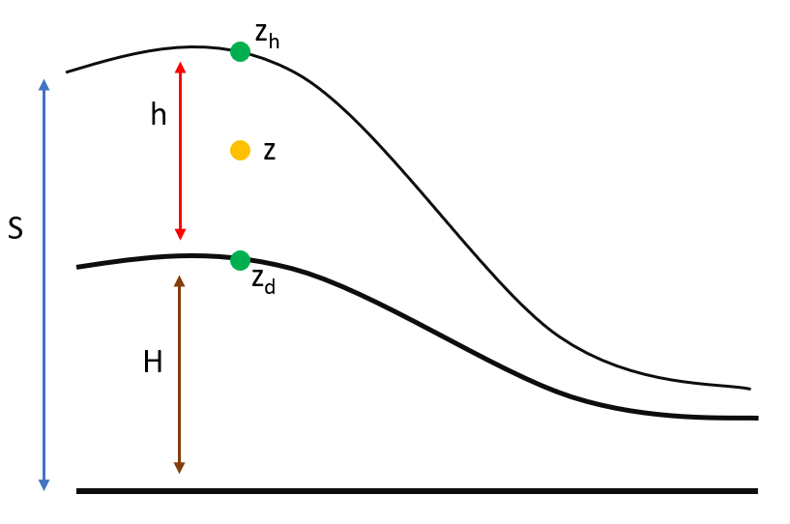
The viscosity
Initial formulas -> differential operator -> green function ->
Velocity update

Slide 19
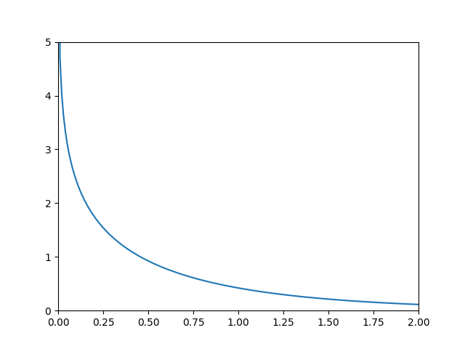
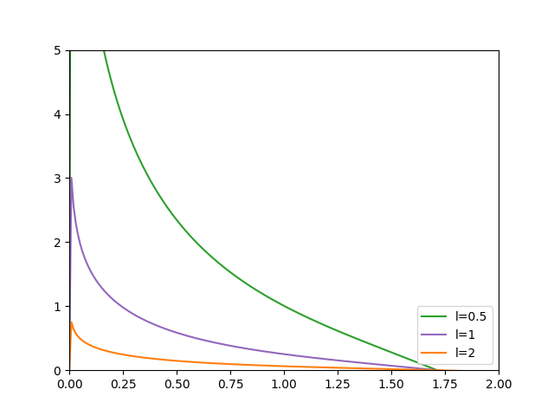
The viscosity
Modified Bessel function
New kernel formula

Slide 20
The algorithm
X(t+dt) = x(t) + u(t+dt) (explicit forward Euler)

Slide 21
The algorithm

Slide 22
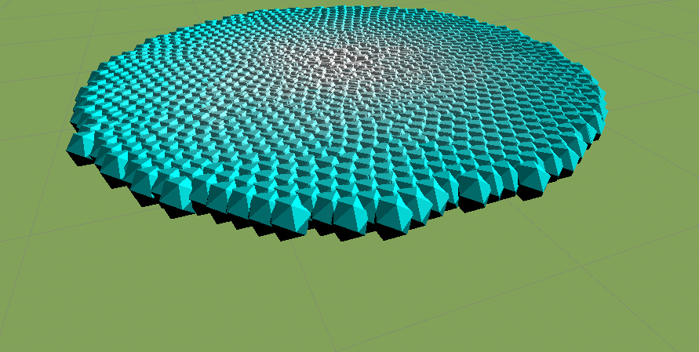
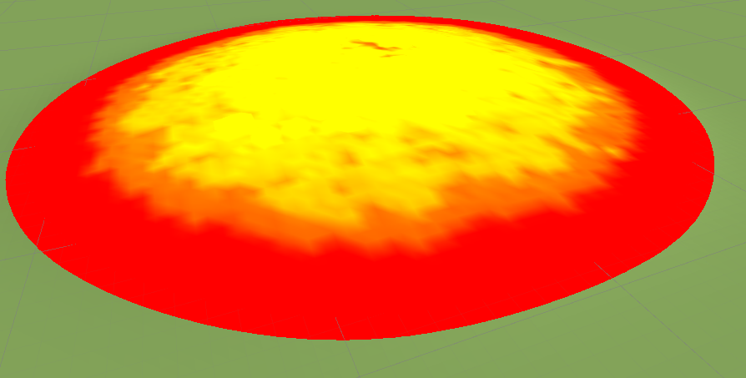
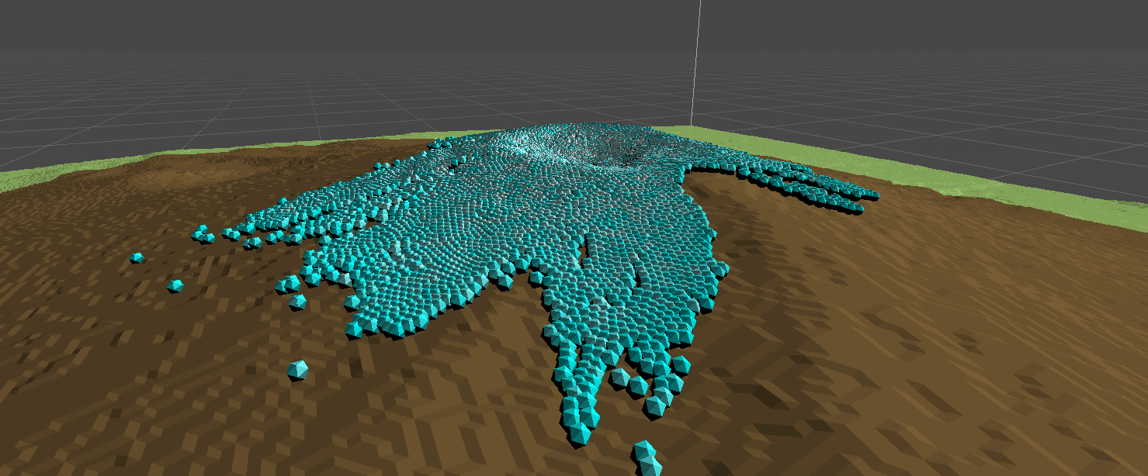
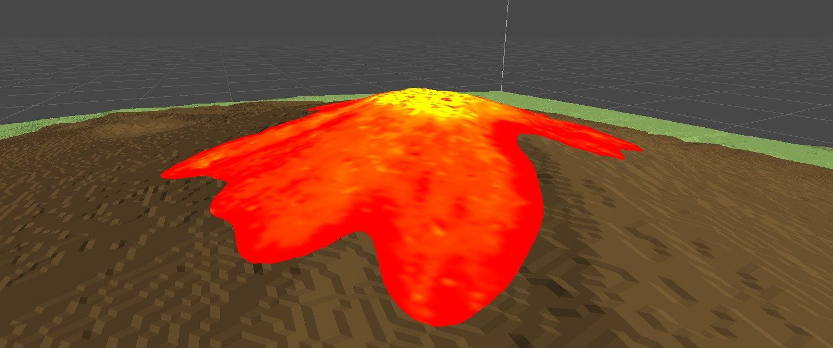
Implementation and Rendering

Slide 23
Final results
Video of lava flow

Slide 24
Thanks

Slide 25
Refs

Slide 26
Questions ?

